Slide 1


Department of BES-I
COURSE: Data Structures
COURSE CODE: 24SC1203
Name of the topic:
Extendible Hashing
Session – 24

Slide 2



AIM OF THE SESSION
To familiarize students with the basic concept of Extendible hashing
INSTRUCTIONAL OBJECTIVES
This Session is designed to:
Demonstrate Extendible hashing that can avoid collisions in the hash table..
List out the advantages, disadvantages and applications of extendible hashing.
LEARNING OUTCOMES
At the end of this session, you should be able to:
Define Extendible hashing.
Describe rehashing method.
Summarize definition, its advantages, disadvanges and its applications

Slide 3
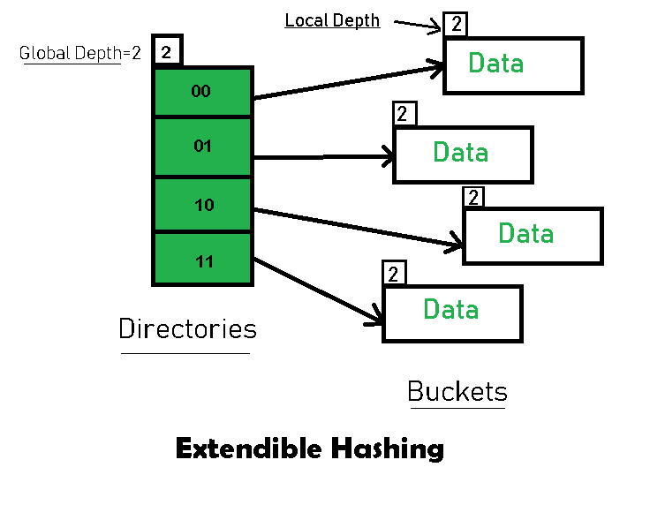
Extendible Hashing
Extendible Hashing is a dynamic hashing method wherein directories, and buckets are used to hash data. It is an aggressively flexible method in which the hash function also experiences dynamic changes.
Basic Structure of Extendible Hashing:
The main features in this hashing technique are:
i) Directories: To store addresses of the buckets in pointers. An id is assigned to each directory which may change each time when Directory Expansion takes place.
ii) Buckets: To store the actual data.

Slide 4
Extendible Hashing
Terms used in Extendible Hashing:
Directories: Instead of using a single hash table, extendible hashing uses a multi-level directory structure.
Buckets: Each directory entry points to a bucket, which stores a subset of key-value pairs.
Local Depth: Each bucket has a local depth, means the number of bits from the hash value used for addressing within that bucket.
Global Depth: The directory's global depth determines the maximum number of bits used for addressing.
Bucket Splitting: When the number of elements in a bucket exceeds a particular size, then the bucket is split into two parts.
Directory Expansion: Directory Expansion Takes place when a bucket overflows. Directory Expansion is performed when the local depth of the overflowing bucket is equal to the global depth.

Slide 5
Extendible Hashing
Example:
Consider elements: 16,4,6,22,24,10,31,7,9,20,26 with bucket Size 3.
Hash Function: Suppose the global depth is X.
Then the Hash Function returns X LSBs.
First, calculate the binary forms of each given numbers.
16- 10000
4- 00100
6- 00110
22- 10110
24- 11000
10- 01010
31- 11111
7- 00111
9- 01001
20- 10100
26- 11010

Slide 6
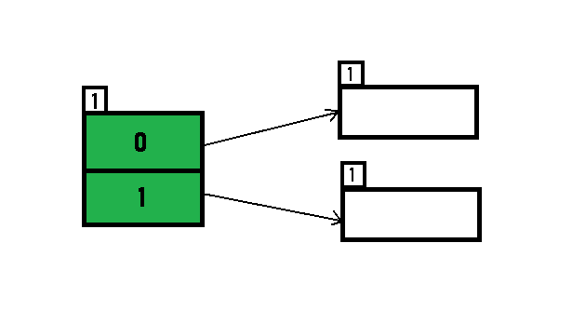
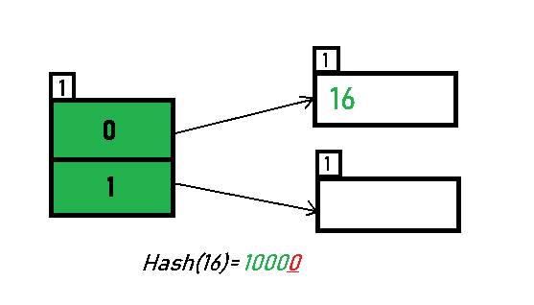
Extendible Hashing
Initially, the global-depth and local-depth
is always 1.
Inserting 16:
The binary format of 16 is 10000 and
global-depth is 1.
The hash function returns 1 LSB of 10000
which is 0. Hence, 16 is mapped to the directory
with id=0.

Slide 7
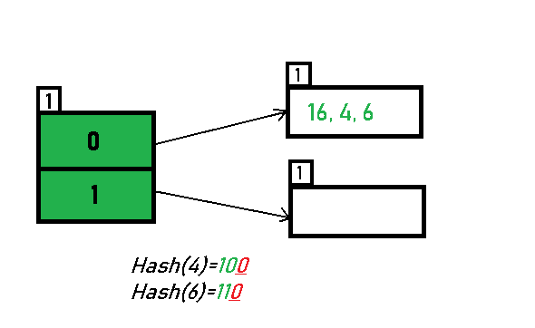
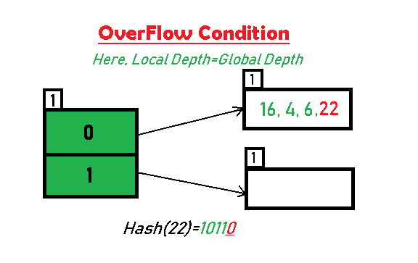
Extendible Hashing
Inserting 4 and 6:
Both 4(100) and 6(110)have 0 in
their LSB. Hence, they are hashed
as follows:
Inserting 22: The binary form of 22 is
10110. Its LSB is 0. The bucket pointed
by directory 0 is already full. Hence,
overflow occurs.

Slide 8
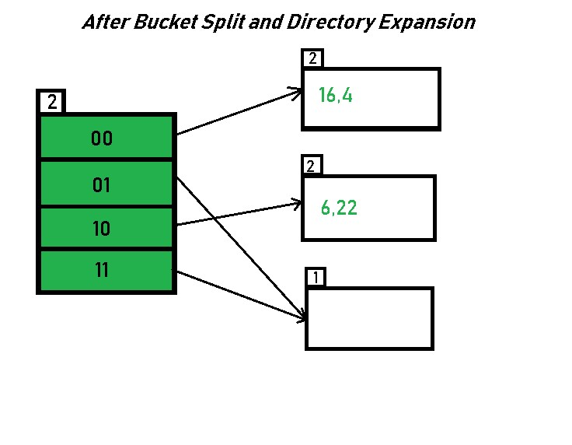
Extendible Hashing process
Since, Local Depth = Global Depth,
The bucket splits and directory expansion takes place. Also, rehashing numbers present in the overflowing bucket takes place after the split.
Hence, 16,4,6,22 are now rehashed w.r.t 2 LSBs.
16 (10000),
4 (100),
6 (110),
22 (10110).
Note : The bucket which was underflow has remained untouched

Slide 9
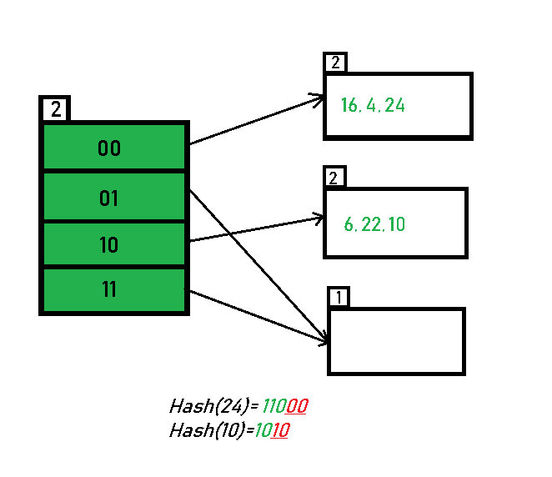
Extendible Hashing process
Inserting 24 and 10:
24 (11000), and
10 (1010).

Slide 10
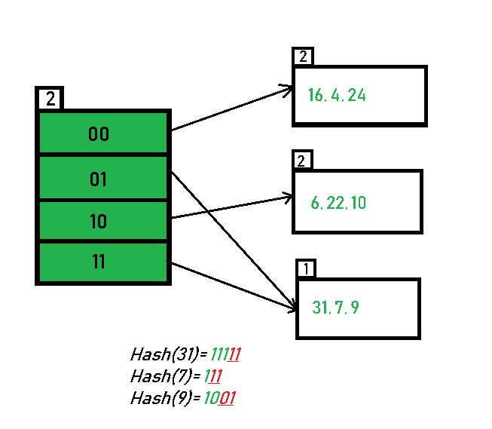
Extendible Hashing process
Inserting 31, 7, 9:
31 (11111),
7 (111),
9 (1001).
have either 01 or 11
in their LSBs.

Slide 11
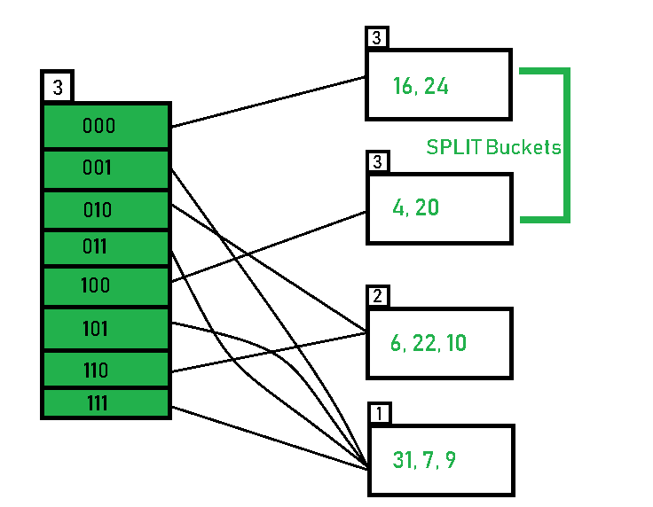
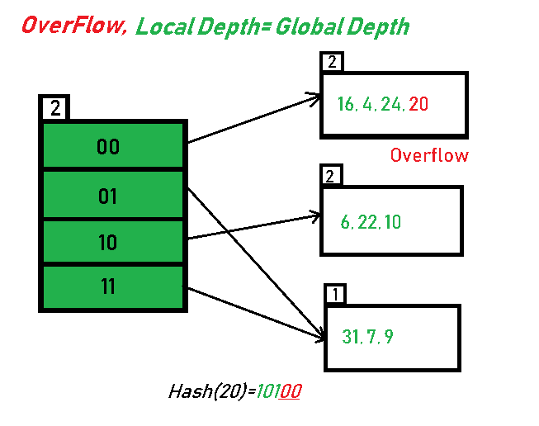
Extendible Hashing process
since the local depth of the bucket = global-depth, directory expansion (doubling) with bucket splitting.
After Expansion and Splitting

Slide 12
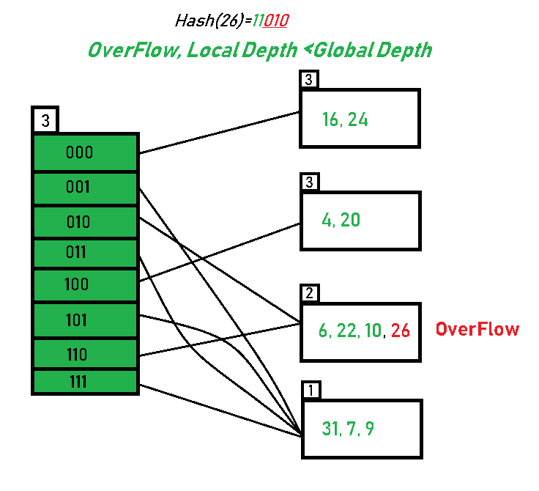
Extendible Hashing process
Inserting 26:
Global depth is 3.
Hence, 3 LSBs of 26(11010)
The bucket overflows, since the local depth of bucket < Global depth (2<3), directories are not doubled but, only the bucket is split and elements are rehashed.

Slide 13
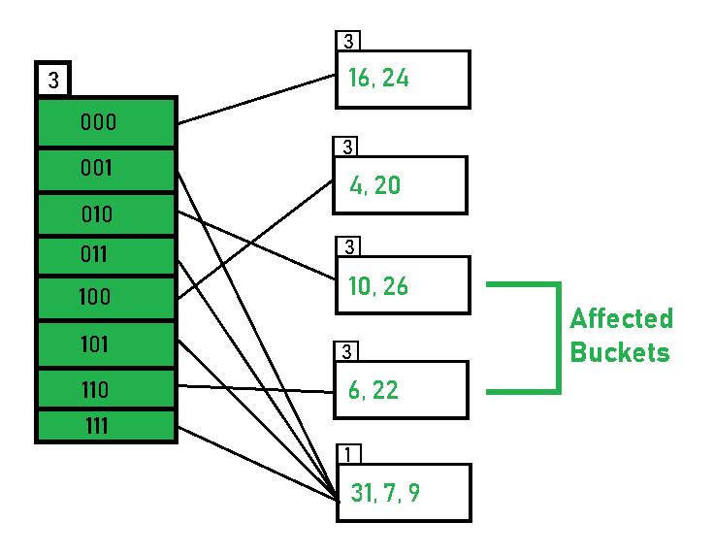
Extendible Hashing process
After Splitting, The buckets are:
Hence, Hashing of all given 11 Numbers is Completed.

Slide 14
Advantages & Disadvantages of Extendible Hashing
Advantages of Extendible Hashing
Data retrieval is less expensive (in terms of computing).
No problem of Data-loss since the storage capacity increases dynamically.
With dynamic changes in hashing function, associated old values are rehashed w.r.t
the new hash function
Disadvantages of Extendible Hashing
Increased algorithm complexity
Extra memory overhead to store index inside the bucket.
Memory is wasted in pointers when the global depth and local depth difference becomes drastic.
This method is complicated to code.

Slide 15
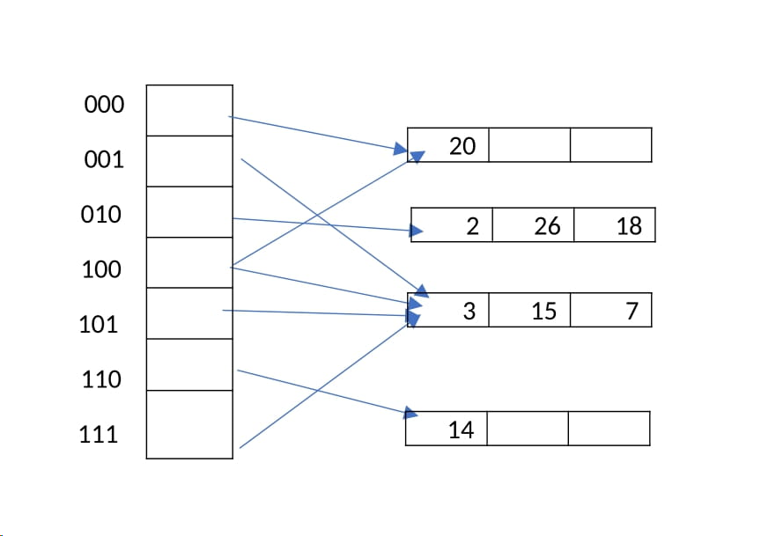
Practice Problem
Consider an extendible hashing structure that, each bucket can hold up to 2 records. Is initially empty (only one empty bucket). Consider the result after inserting keys 8, 16, 4, 3, 11, 12 in order, using the lowest bits for the hash function. That is records in a bucket of local depth d agree on their rightmost d bits. For example, key 4 (0100) and key 12(1100) agree on their rightmost 3 bits (100). What is the global depth of the resulting directory? Now insert key 18. What is the local depth of the bucket that contains key 18?

Slide 16
IMPORTANT FACTS RELATED TO THE SESSION
Applications of Extendible Hashing
All modern file systems use extendible hashing.
Extendible hashing is widely used in database systems and applications requiring dynamic and scalable indexing.

Slide 17
SUMMARY
Extendible Hashing is a dynamic hashing method wherein directories, and buckets are used to hash data. It is an aggressively flexible method in which the hash function also experiences dynamic changes.
Number of Directories = 2^Global Depth.
Extendible hashing is a dynamic hashing technique used in data structures to manage growing datasets efficiently.
It uses a directory of pointers to buckets, allowing the hash table to grow or shrink dynamically without extensive reorganization. Hash values are represented as binary bits, and only a prefix of these bits is used to index the directory, which expands as needed to resolve collisions.

Slide 18
SELF-ASSESSMENT QUESTIONS
1. Rehashing is also called as . . . . . .
A. Internal hashing B. External hashing C. Extendible hashing D. Uniform hashing
2. In extendible hashing ___________ is used in the directory
a) Global depth b) Local depth c) Load factor d) All the above.
2. In extendible hashing what is the initial values for local depth and global depth?
a) 0 0 b) 1 1 c) 2 2 d) 3 3

Slide 19
TERMINAL QUESTIONS
1. Mention the condition that demmands the bucket splitting in the extendible hashing?
2. When is rehashing done?
3. What is local depth, global depth?
4. What is the purpose of Directory and Bucket in the extendible hashing?
5. List out the applications of extendible hashing?

Slide 20
REFERENCES FOR FURTHER LEARNING OF THE SESSION
Reference Books:
  Mark Allen Weiss, Data Structures and Algorithm Analysis in C, 2010 , Second Edition, PearsonEducation.
  Ellis Horowitz, Fundamentals of Data Structures in C: Second Edition, 2015
  A.V.Aho, J. E. Hopcroft, and J. D. Ullman, “Data Structures And Algorithms”, Pearson Education, First Edition Reprint2003.
Sites and Web links:
1. https://nptel.ac.in/courses/106102064
2. https://in.udacity.com/course/intro-to-algorithms--cs215
3. https://www.coursera.org/learn/data-structures?action=enroll

Slide 21
THANK YOU
Team – Data Sructures

